Slide 1
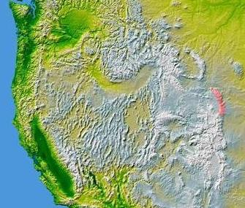
Research wells:
Blair Wallis well field:
boreholes completed in both saprolite (eroded granite & metamorphic rocks) & underlying bedrock;
Bedrock wells: BW1-BW9;
Government Gulch:
Wells completed in basement granite and overlying basin fills at the mountain front;
Laramie
(UW)
Cheyenne
WY
CO
High
Plains
Aquifer
Laramie Range
Belvoir Ranch wells:
(Casper Fm.) bedrock wells, shallow riparian wells, & stream gages – all in the outcrop area at the mountain front;
http://geofaculty.uwyo.edu/yzhang/
ATLAS TCE plume in High Plains:
Drawing is not to scale: the plume is about 1 mile wide, 10 miles long, and a few hundred feet deep.

Slide 2
Blair Wallis Fractured Rock Research Well Field
Geology: fractured granite & metamorphic rock overlain by weathered granite;
Hydrology: SW/GW dominated by snowmelt.
Hydrological research:
SW/GW monitoring;
well tests (single & cross-hole);
borehole profiling (FLUTe liner, televiewer, flowmeter logs);
Geophysical research: borehole & surface (seismic, resistivity, GPR, NMR, gravity, etc.)
Petrophysics research: from field to mountain scale;

Slide 3
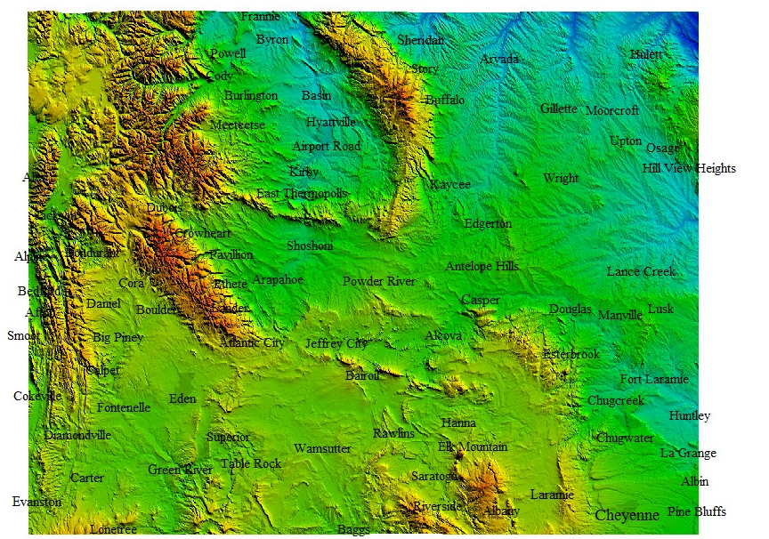
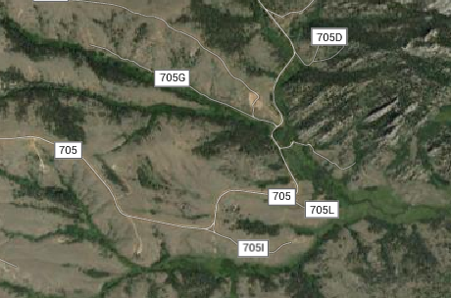
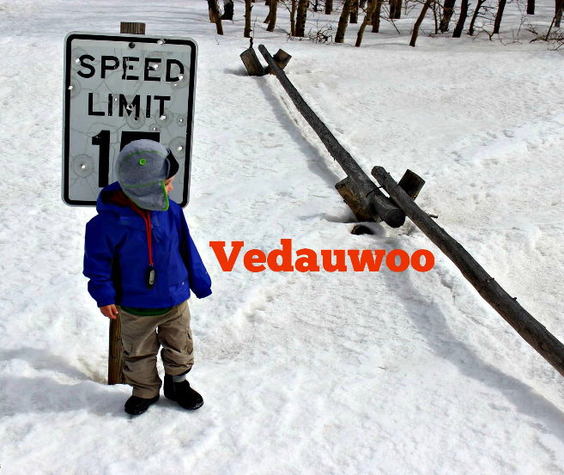
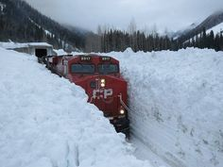
Blair Wallis Fractured Rock Hydrology Research
Wyoming
http://www.justtrails.com/tag/vedauwoo/

Slide 4
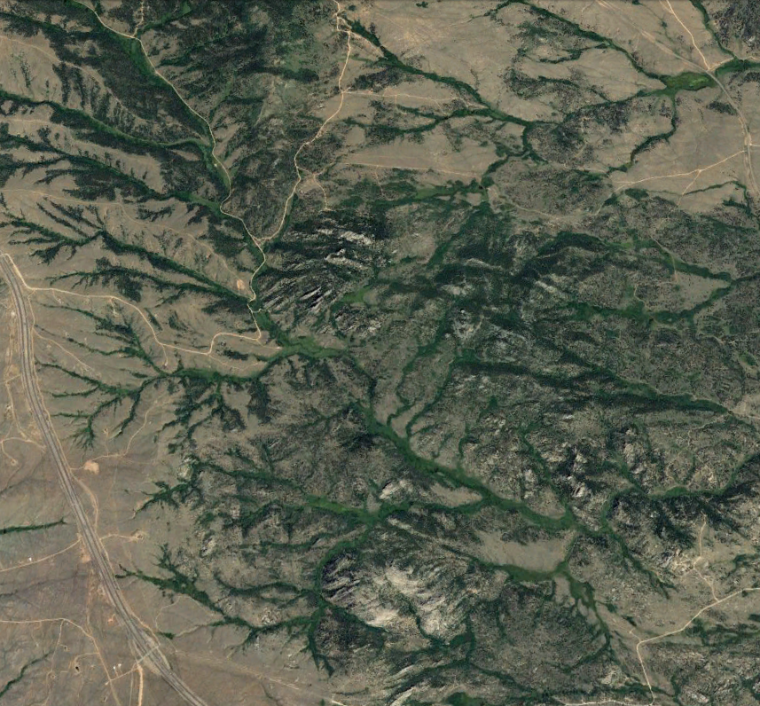
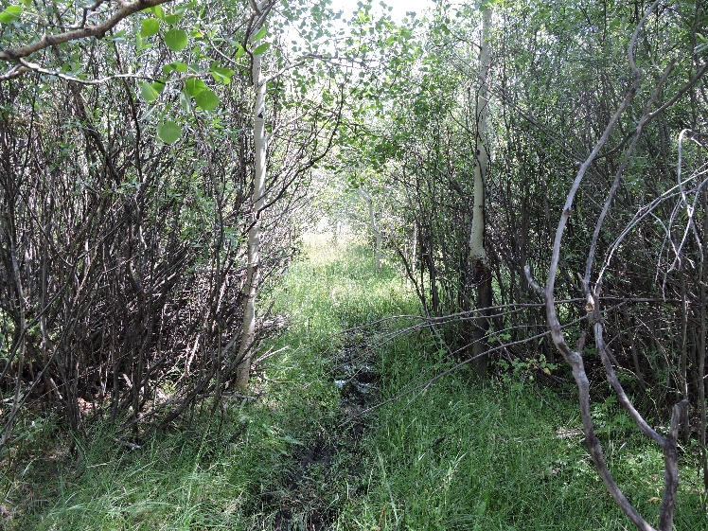
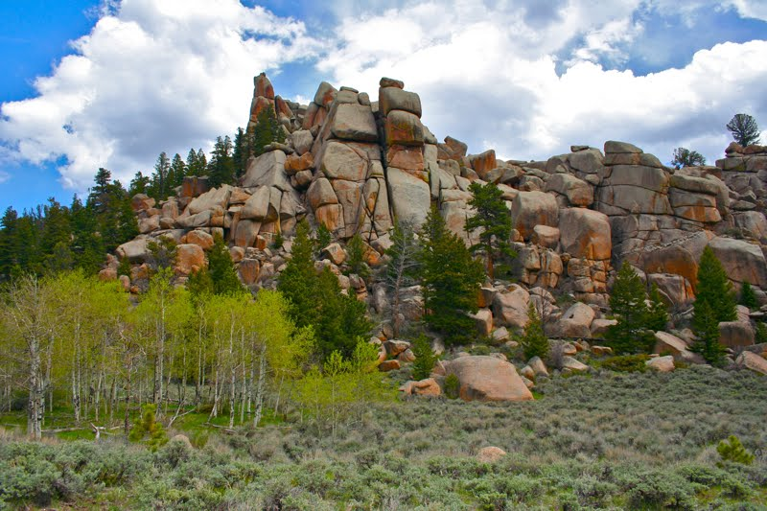
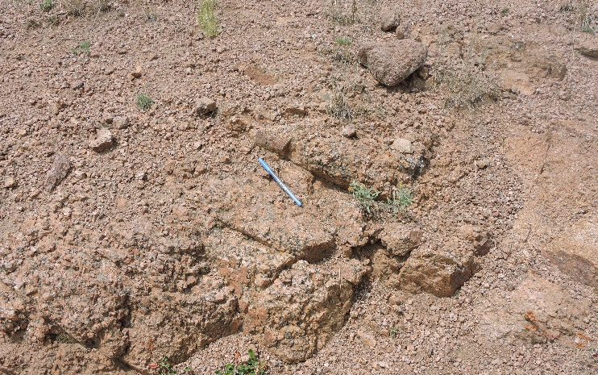
Regional view
N
Wetland
wetland
Granite outcrop
Outcrop
Granite outcrop
Blair Creek
Well field
Blair Creek
Medicine Bow
National Forest
Weather granite (saprolite)
Lineaments
Granite outcrop
0
1
2
km

Slide 5
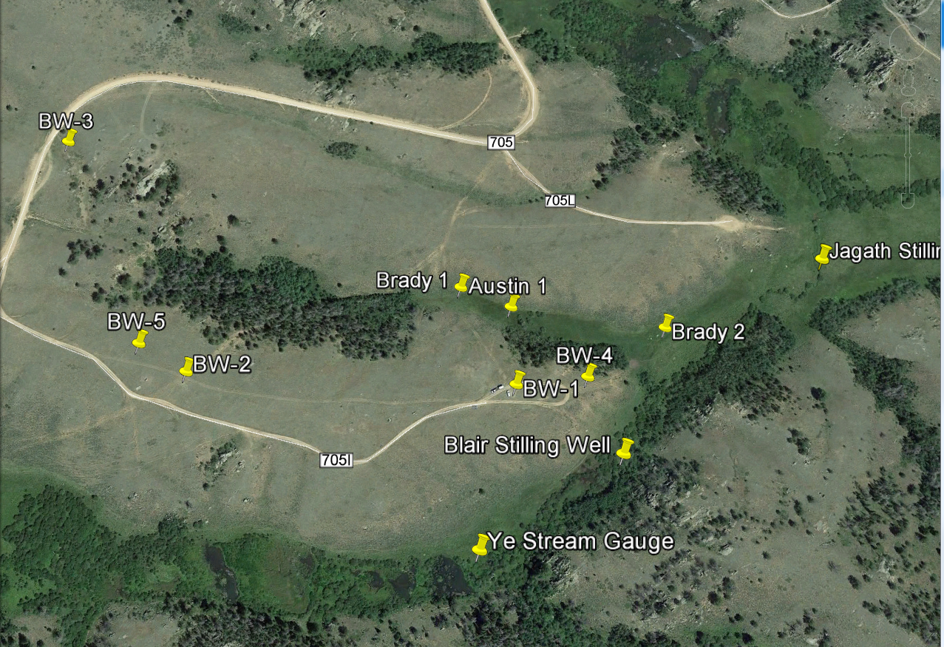
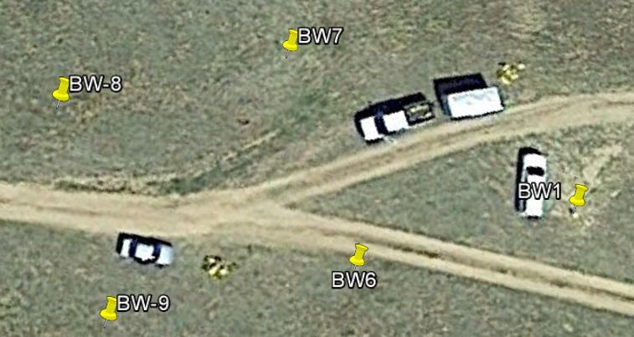
Blair Wallis Fractured Rock Hydrology Research Well Field
N
BW 6, 7, 8, and 9 were drilled in Fall 2016: cross-hole communication is observed with BW1
wetland
Blair Creek
0
100
200
m
http://geofaculty.uwyo.edu/yzhang/files/Blair_Hydraulics_Research.pdf
http://geofaculty.uwyo.edu/yzhang/files/Summary_HydraulicTests_2015.pdf
http://geofaculty.uwyo.edu/yzhang/files/Step_test_BW6.pdf

Slide 6
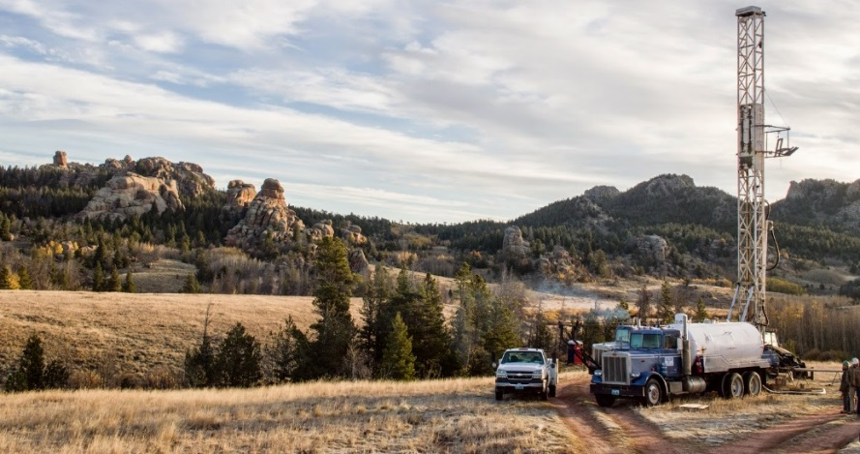
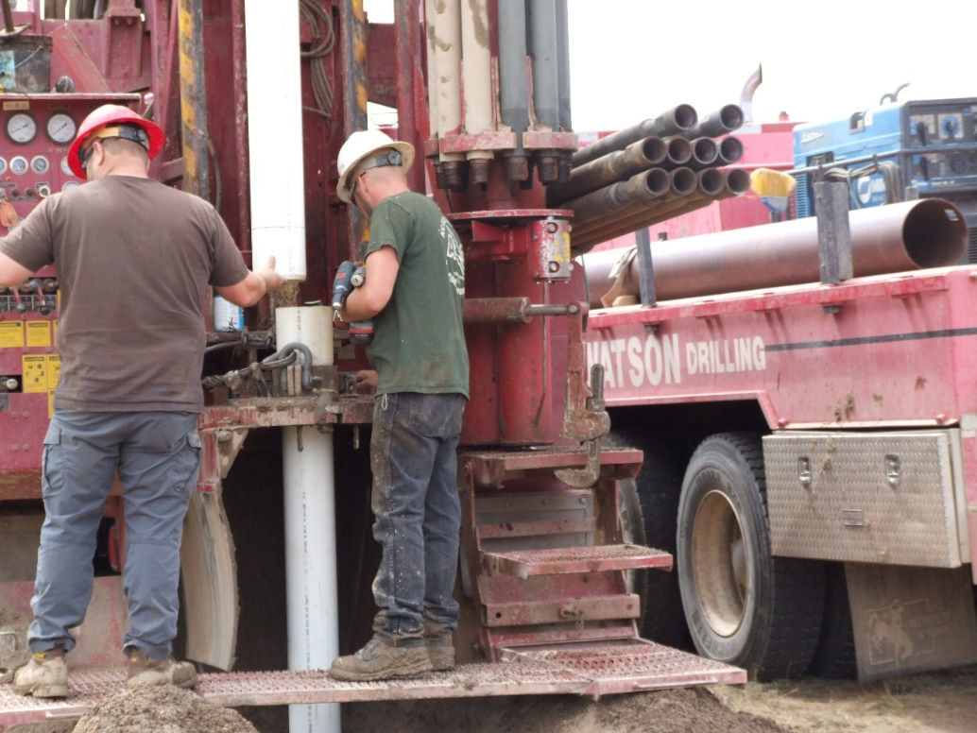
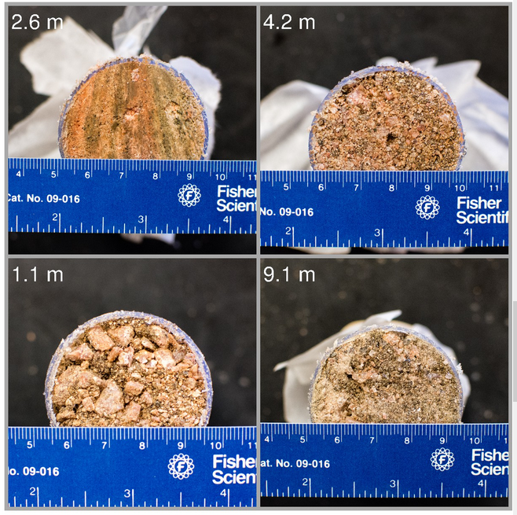
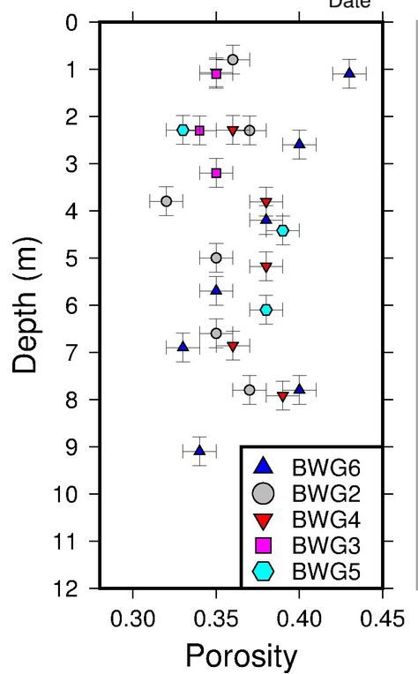
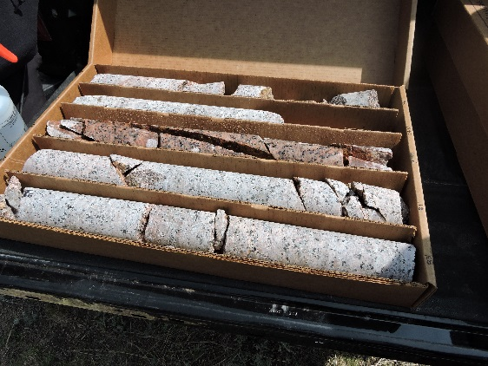
Drilling at Blair
Setting surface casing made of PVC at BW6
Coring at BW5 (Jordan Hayes)
Saprolite Samples & NMR porosity profile in saprolite (Brady Flinchum)

Slide 7
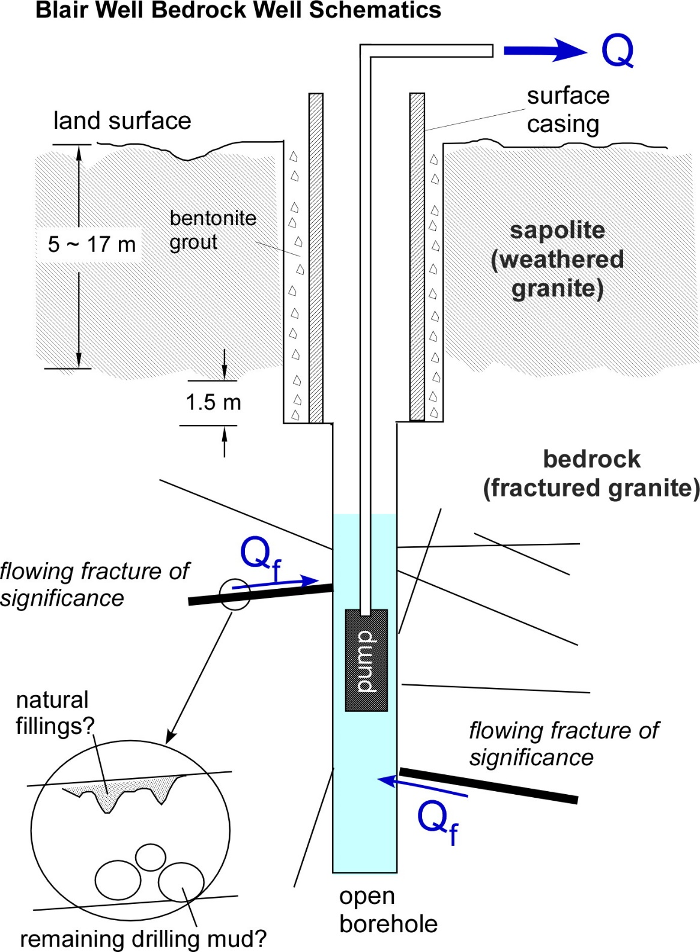
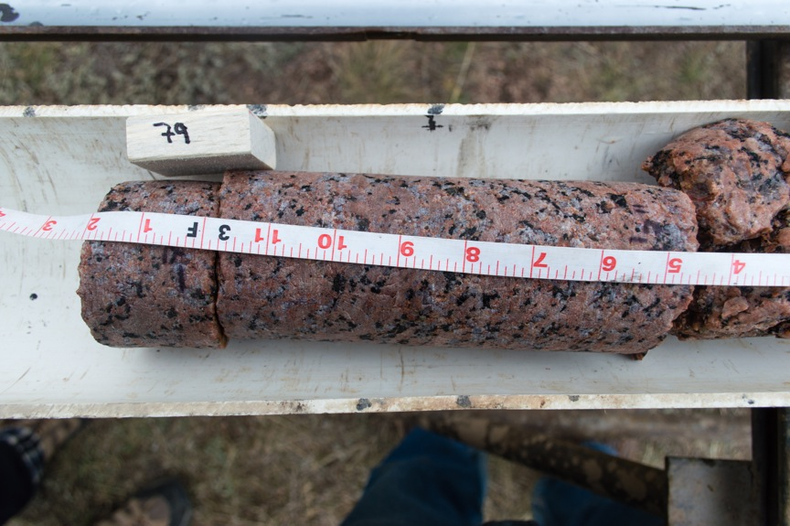
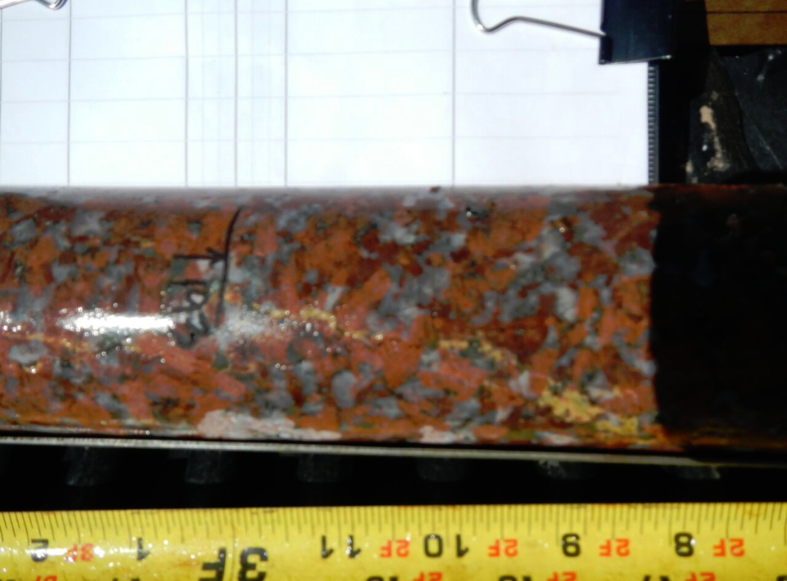
Bedrock cores: Classic Sherman
Bedrock cores: Sulfide-Rich Sherman from BW4

Slide 8
 | BW-1 | BW-2 | BW-3 | BW-4 | BW-5 | BW-6 | BW-7 | BW-8 | BW-9
Coord. | 41.183939° N, 105.394125° W | 41.183888° N, 105.397732° W | 41.185873° N, 105.399440° W | 41.184046° N, 105.393329° W | 41.184099° N, 105.398273° W | 41.183842° N, 105.394332° W | 41.183989° N, 105.394456° W | 41.183904° N, 105.394667° W | 41.183753° N, 105.394551° W
TD (m) | 30.27 | 16.03 | 39.10 | 58.61 | 39.02 | 60.76 | 72.83 | 76.2 | 60.96
Casing depth (m) | 17 | 6.1 | 6.7 | 9.8 | 18 | 17.07 | 17.07 | 16.76 | 17.07
Casing diameter (inch) | 7’’ steel casing | 7’’ pvc casing | 7’’ pvc casing | 4’’ pvc casing | 4’’ pvc casing | 6’’ pvc casing | 6’’ pvc casing | 6’’ pvc casing | 6’’ pvc casing
Borehole diameter^{*1} (inch) | 4 7/8’’ | 5.5’’ | 5.5’’ | ~3.8’’ | ~3.8’’ | 5’’ | 5’’ | 5’’ | 5’’
Rock type | Classic Sherman | Classic Sherman | Classic Sherman | Sulfide-rich Sherman | Classic Sherman | Classic Sherman | Classic Sherman | Classic Sherman | Classic Sherman
DTW (m)^{*2} | 11.8 (8/15/2015) | 11.03 (11/18/2015) | 5.7 (9/11/2015) | 11.7 (11/18/2015) | 10.9 (9/11/2015) | 13.18 from toc (9/8/2016) 12.645 bgs (8/31/2016) | 11.835 from toc? (9/8/2016) 11.755 bgs (9/1/2016) | 13.743 (12/8/2016) | 12.947 (12/8/2016)
Drilling method | air/water rotary +coring; airlifted; | air/water rotary +coring; not developed | wireline+coring (drilled with water); not developed | wireline+coring (drilled with water); airlifted; | wireline+coring (drilled with water); airlifted; | air/water rotary + downhole hammer^{*3} airlifted; | air/water rotary + downhole hammer; airlifted; | air/water rotary + downhole hammer; airlifted; | air/water rotary + downhole hammer; airlifted;
*1 This is diameter of the open borehole beneath the casing (see the diagram on previous page; also see caliper logs); *2 From top of casing (TOC) unless it is labeled as bgs (below ground surface); continuous WL monitoring is available since May, 2015. *3 No corings for BW 6, 7, 8, and 9. Note most shallow saprolite wells (Brady’s; Austin’s) in Blair Wallis were drilled using the backpack shaw drill.

Slide 9
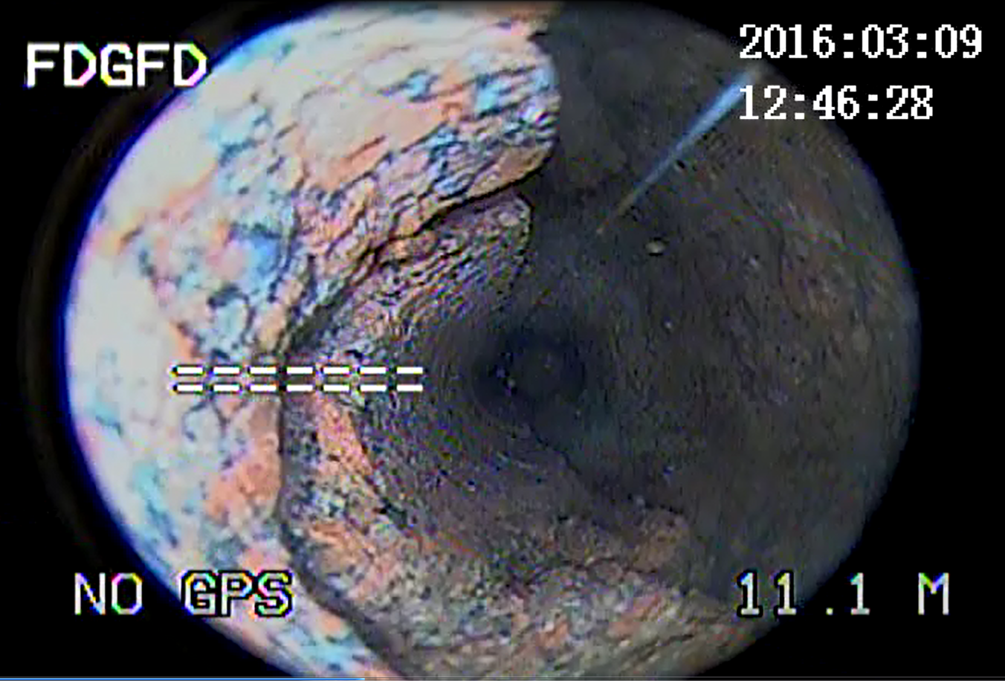
Well Field Observations
Numerous bedrock fractures, variable orientations, observed in cores & logs;
Short-term pumping tests (up to 44 hr): (1) low to moderate productivity; (2) fresh water (TDS<150 mg/l); (3) a few wells produced suspended sediments (granite minerals & clay);
Slug tests (BW1-9): bedrock equivalent K_{H}: 10⁻⁷~10⁻⁴ m/s (fine-medium sand);
FLUTe K profile (BW 5, 6, 7): (1) 10⁻⁸~10⁻⁵ m/s; (2) hydraulically active zone down to 53 m depth;
Mean bulk fracture porosity: 0.04%;
Fracture (ambient) flow velocity: 0.4~80 m/day;
Cross-hole interference tests (BW 1, 6, 7, 8): differential drawdowns for each test → strong heterogeneity
28 hr pumping test @ 20 gpm;
Total drawdown in BW4 is ~12 m;
BW1, 60 m away, had no response;
Notes:
From the hydraulic and geophysical monitoring and testing data collected in the well field, we aim to build integrated models to quantify the rate and pathway of GW and its interaction with surface water and snowmelt.

Slide 10
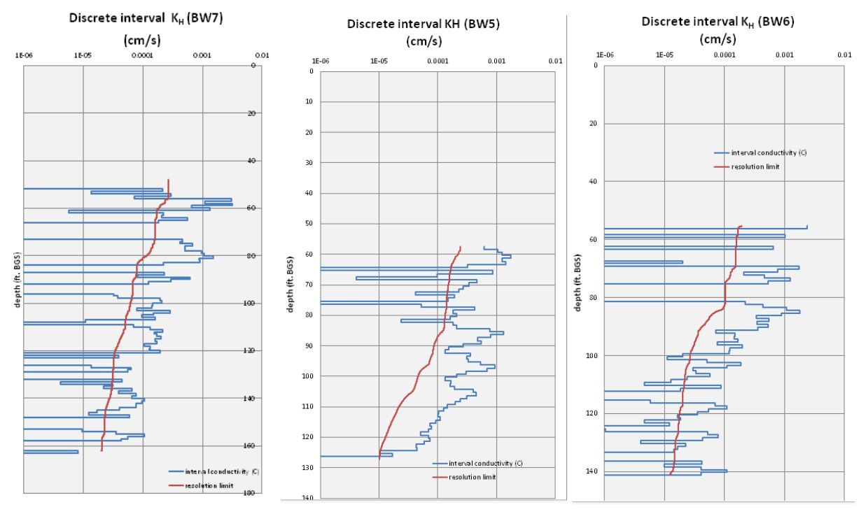
Surface casing
(saprolite)
Weathering front?

Slide 11
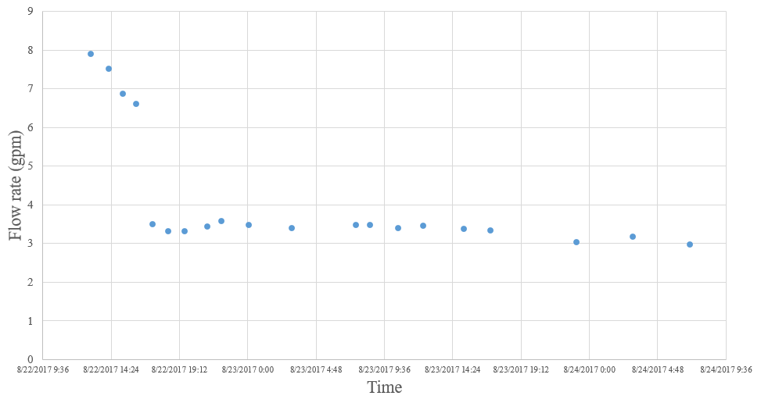
BW 7 Test
Sediments cause pumping rate to reduce;
Drawdown stabilization after 44 hr:
water-supply BC? Blair Creek (30 m E of well field) ran dry ~ 1 week days later;
Differential drawdowns observed in nearby wells
Sediment production
Notes:
6.5gpm to 3.5gpm at the first ‘major’ water level rise.

Slide 12
BW-4:
Lies in a different type of granite;
A low-k underground dyke likely exist as a flow barrier between BW-4 and the rest of the well field;
A geomechanical response was likely observed in BW1 during the 28-hour pumping test of BW-4 (http://geofaculty.uwyo.edu/yzhang/files/Summary_HydraulicTests.pdf );
Has the highest k based on limited well test data among the bedrock wells;
Has developed significant deformation, see downhole camera recording when transducer in BW-4 was temporarily stuck:
https://uwy-my.sharepoint.com/personal/yzhang9_uwyo_edu/_layouts/15/guestaccess.aspx?guestaccesstoken=DgcVW0DN5N9iSlk5q%2f0CzUvqZZ4Om5%2fYO0QE8LuxvrQ%3d&docid=12513c8803b9f4f38a3a4f4eb25cffe2a&rev=1

Slide 13
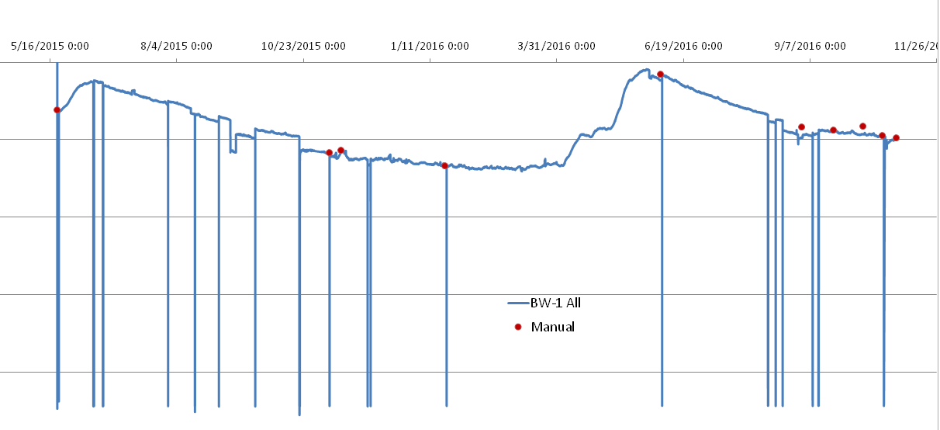
Recharge & Discharge
Recharge: GW level dominated by annual snowmelt; connectivity to surface.
Discharge: GW flow to basin is estimated at 6~19% of the total precipitation over the Range, assuming K at Blair extends to mountain scale.
Notes:
Mention the assumption behind the “discharge” calculation: the local scale K data from the Blair Wallis well field is assumed to extend to the entire Laramie Range.

Slide 14
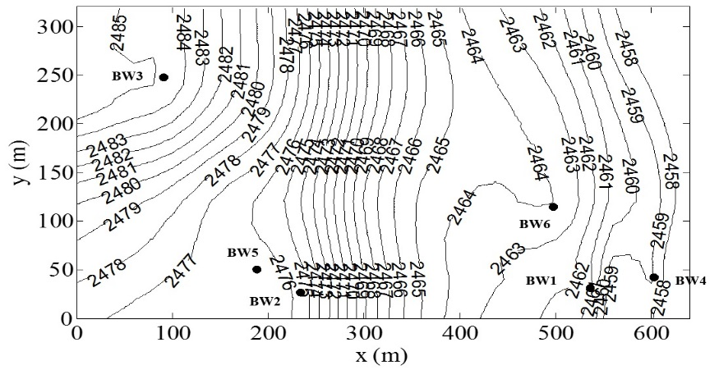
Estimated WL constrained by Lidar DEM & GW inversion
The water level becomes the initial condition for launching the integrated SW/GW simulation.
Estimated GW flow direction assuming a tensorial fracture network effective (continuum) hydraulic conductivity. Orientation is for schematic only. Well tests will determine the large scale K_{Hx}/K_{Hy}.

Slide 15
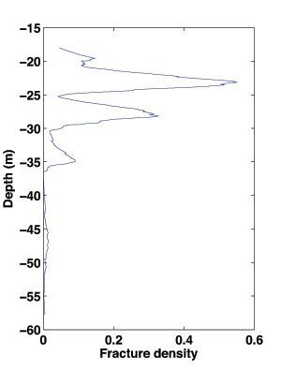
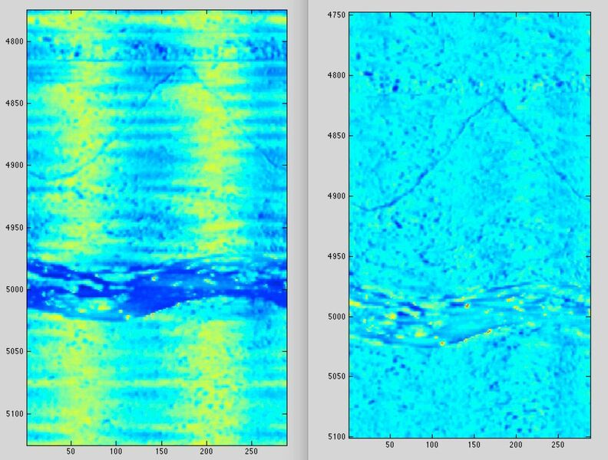
Borehole Geophysics for BW1—BW9 (known to Ye):
Caliper logs;
Downhole NMR;
Sonic velocities;
OBI logs;
acoustic televiewer logs;
Spinner & heat flowmeter logs
VSP;
Electrical resistivity (?);
GPR (?);
ABI Amplitude Kx-filtered horizontal fracture (Courtesy of Brad Carr);

Slide 16
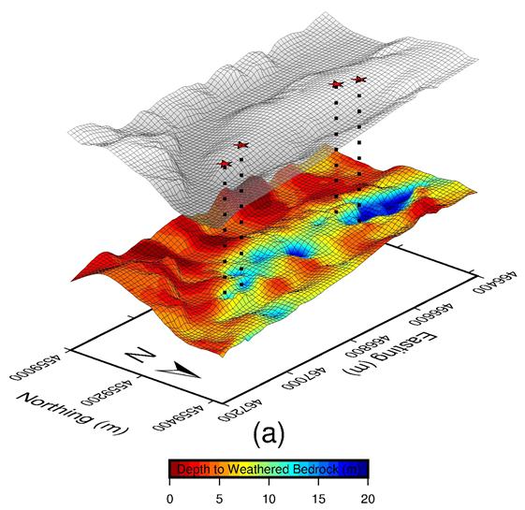
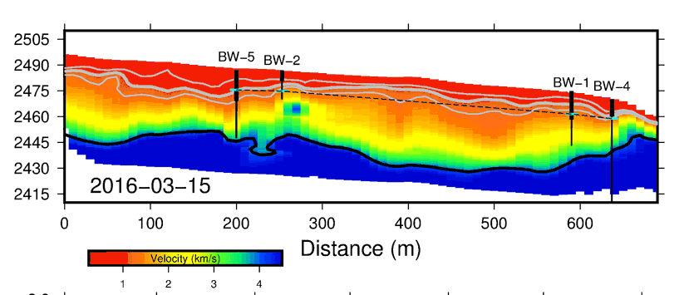
Surface Geophysics (known to Ye):
Subsurface interpretation from seismic refraction data (Curtesy of Brady Flinchum)
Seismic refraction;
Surface NMR;
Electrical Resistivity;
GPR;
Well field
Interpolated average water level from 4 boreholes
Modeled seismic P wave velocity

Slide 17
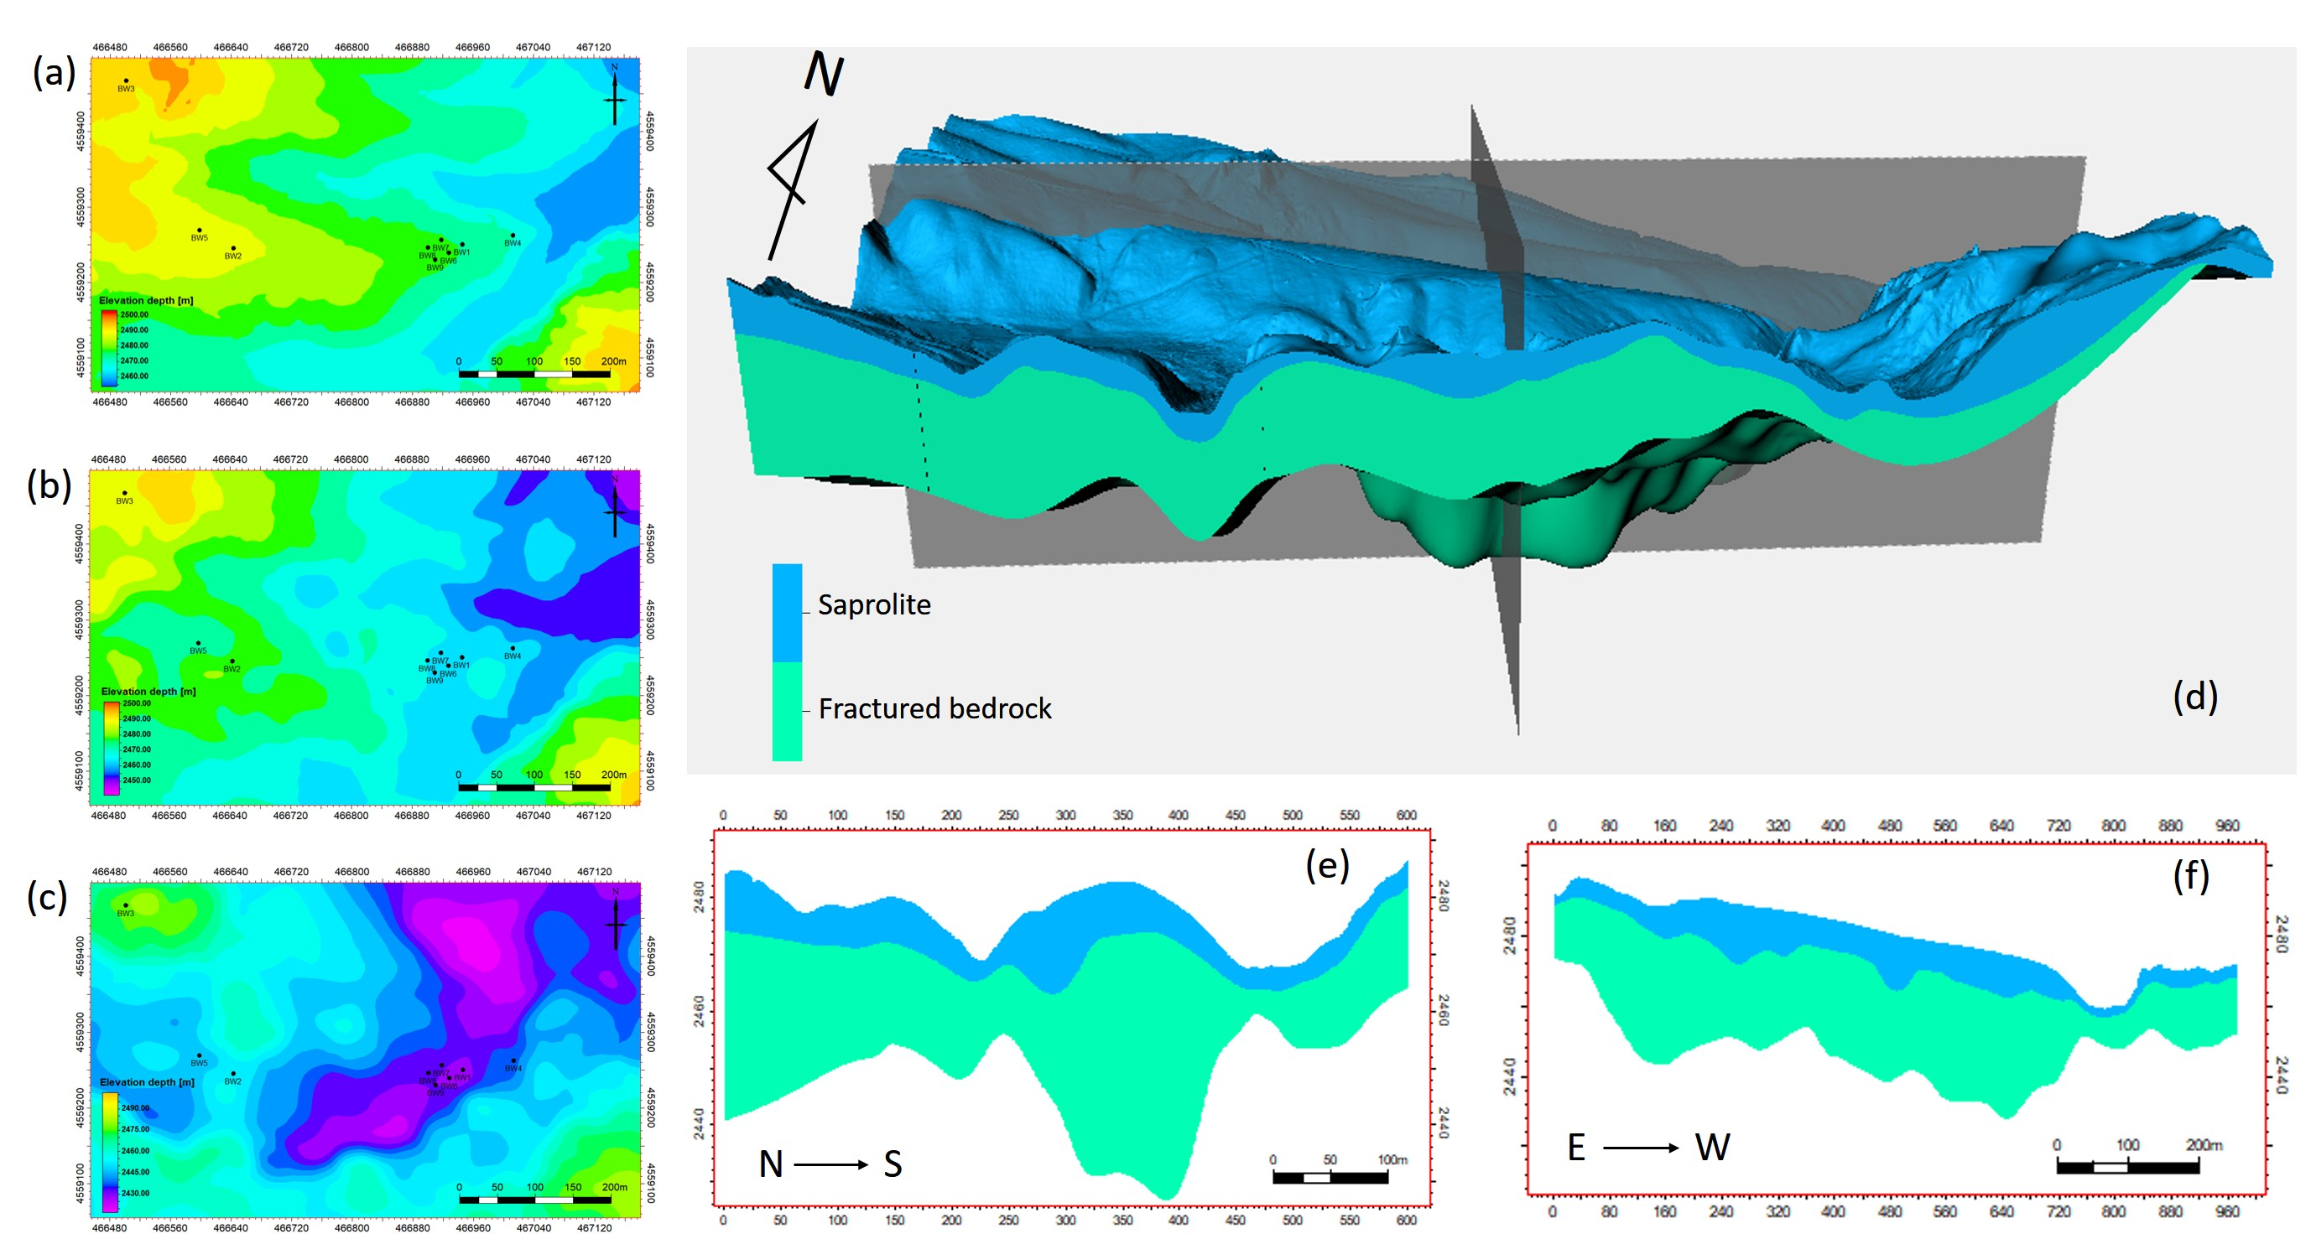
(a) Lidar topography of Blair Wallis well field. (b) Interpreted interface between saprolite and fractured granite by extracting the 1.2 km/s P-wave velocity contour from a kriged volume (Flinchum, 2017). (c) Interpreted interface between fractured granite and less fractured protolith by extracting the 4.0 km/s surface (Flinchum, 2017). (d) A geological model of the well field (vertically exaggerated 4 times) based on (a), (b), c). The fractured bedrock is ~ 4× the thickness of the saprolite*. (e) A N-S cross section through (d). (e) An E-W cross section through (d).
* In the geological model (d), the protolith layer is not shown, as we don’t yet know the thickness of this layer.

